Slide 1
Views and Layouts
CTAPDEVL
Prepared by:
Elizer Ponio Jr.

Slide 2
Contents
What is an Android View?
Organizing Views
Layout

Slide 3
What is an Android View?

Slide 4
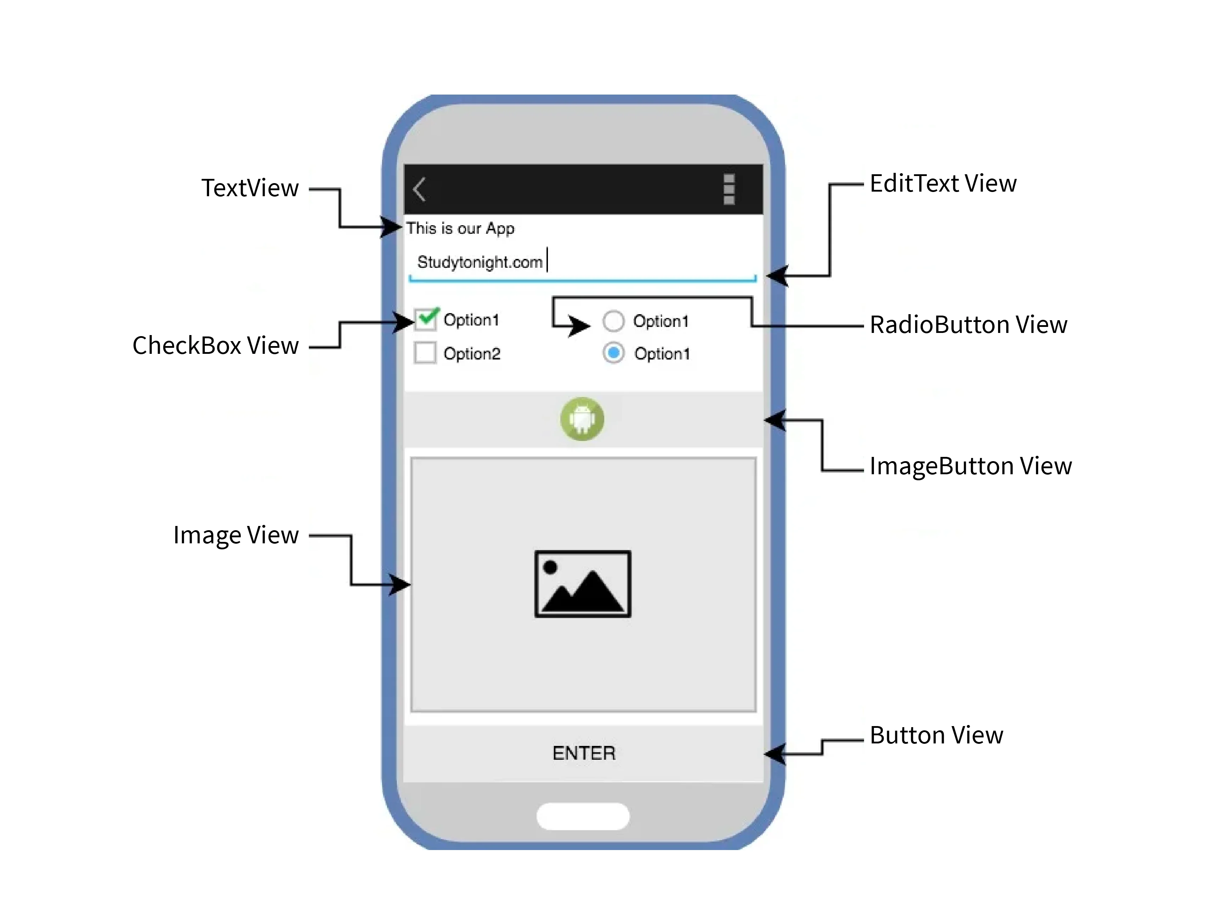
What is an Android View?
In Android, a View is the basic building block for creating UI components.

Slide 5
What is an Android View?
Views are UI components that can can display content or respond to user interactions.

Slide 6
What is an Android View?
Each View is a fundamental element for creating various types of interactive and display components in an app.

Slide 7
Types of Views
Basic types of Views include:
TextView to display text
EditText allows user to input and edit text
Buttons to trigger an event
ImageView for displaying images
CheckBox for making selections
RadioButton for making selections

Slide 8


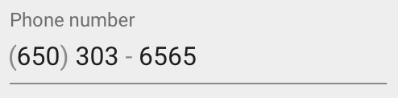


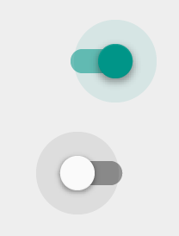
Types of Views
Button
EditText
Slider
CheckBox
RadioButton
Switch

Slide 9


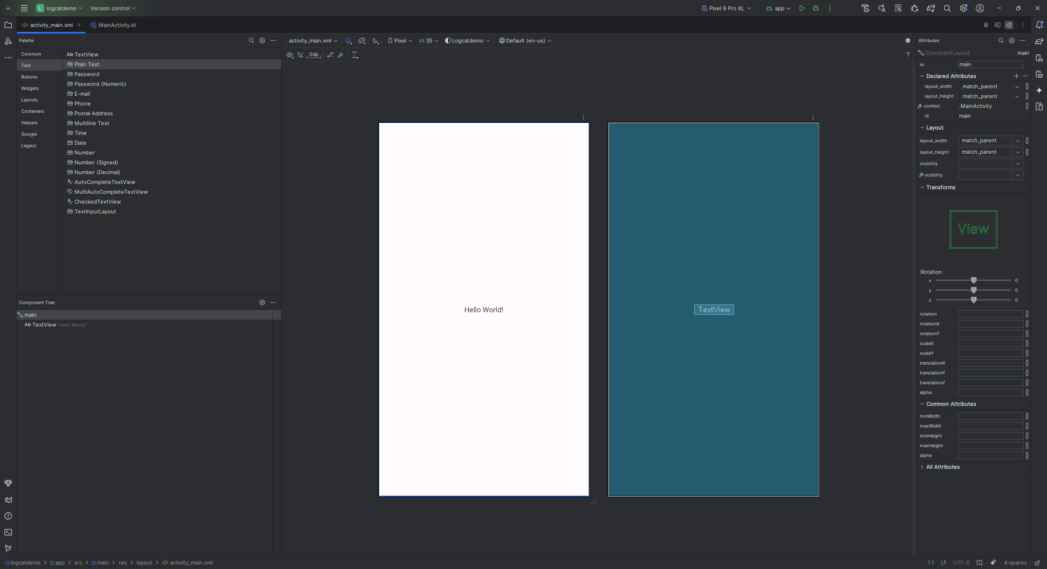


Creating Views
Palette pane
Attributes tab
Component Tree
Design and Blueprint

Slide 10
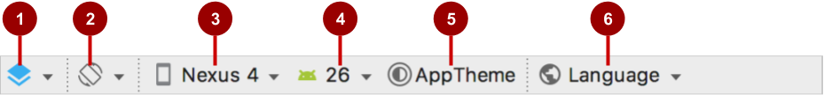
Layout editor main toolbar
Select Design Surface: Design and Blueprint panes
Orientation in Editor: Portrait and Landscape
Device in Editor: Choose device for preview
API Version in Editor: Choose API for preview
Theme in Editor: Choose theme for preview
Locale in Editor: Choose language/locale for preview

Slide 11
Organizing Views

Slide 12
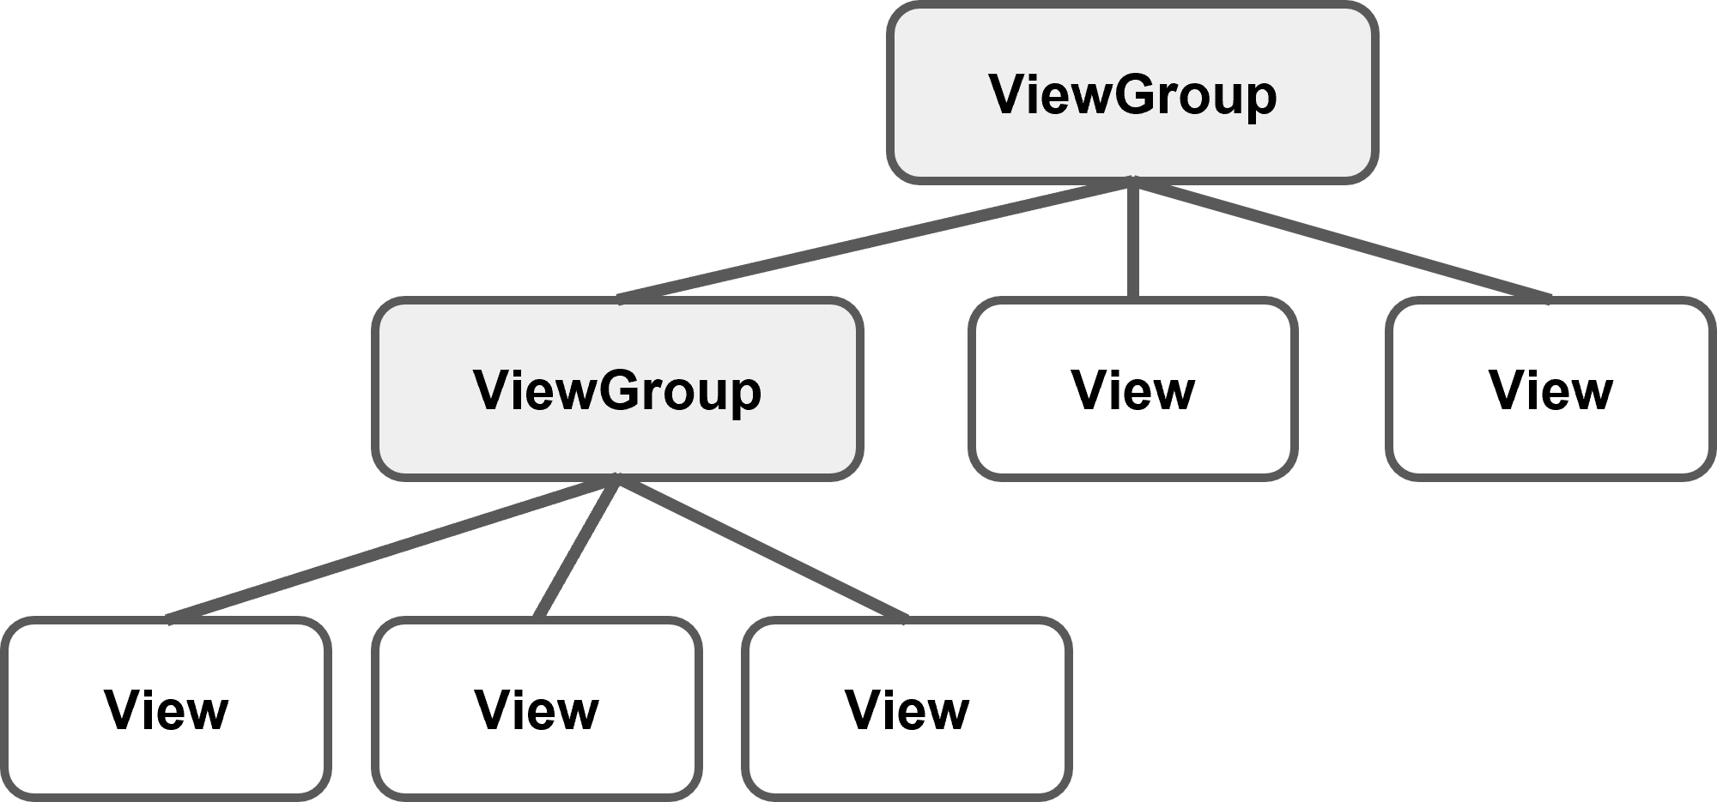
ViewGroup
A ViewGroup is a special view that can contain other views.
It can hold together Views or even other ViewGroups.

Slide 13
ViewGroup
It is essentially a way to combine different Views, allowing for more complex and organized layouts in your app.

Slide 14
View and ViewGroup
A View is a basic UI element that is meant to be displayed on the screen.
A ViewGroup doesn’t display any content of its own but serves as a container to organize and manage other Views.

Slide 15
Layout

Slide 16
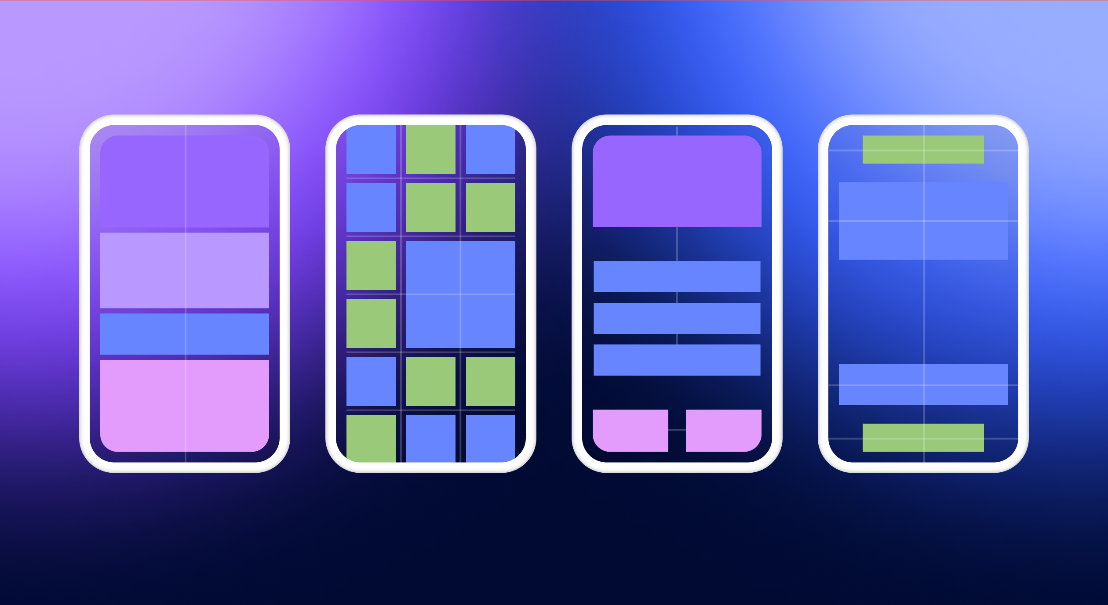
Layout
Layouts are specific types of ViewGroups in Android.
They are a subclass of ViewGroup that provide a different layout structure.

Slide 17
Layout
They dictate how different views and elements are organized on the screen.

Slide 18



Types of Layout
LinearLayout
ConstraintLayout
TableLayout

Slide 19
Linear Layout
LinearLayout is a view group that aligns all children in a single direction, vertically or horizontally.

Slide 20
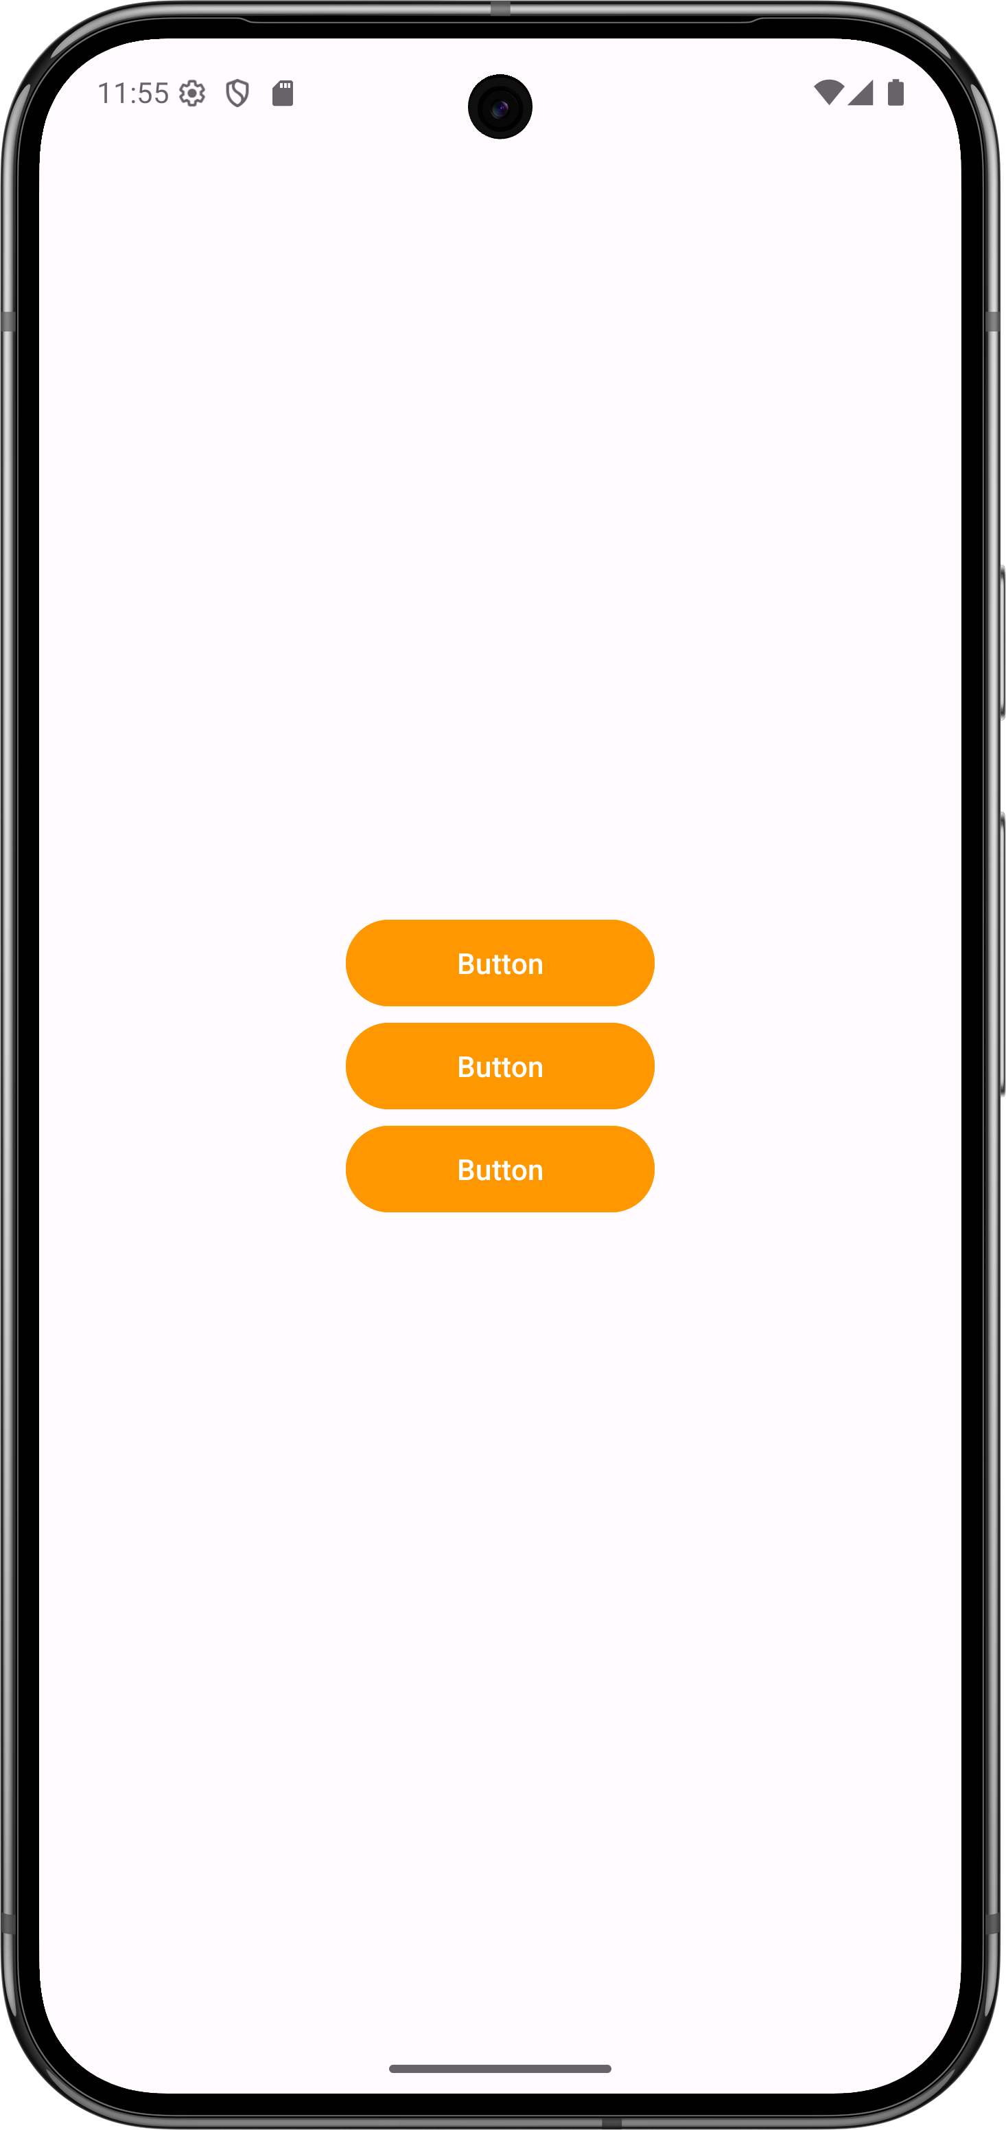
Linear Layout (Vertical)
activity_main.xml
LinearLayout
Button
Button
Button

Slide 21
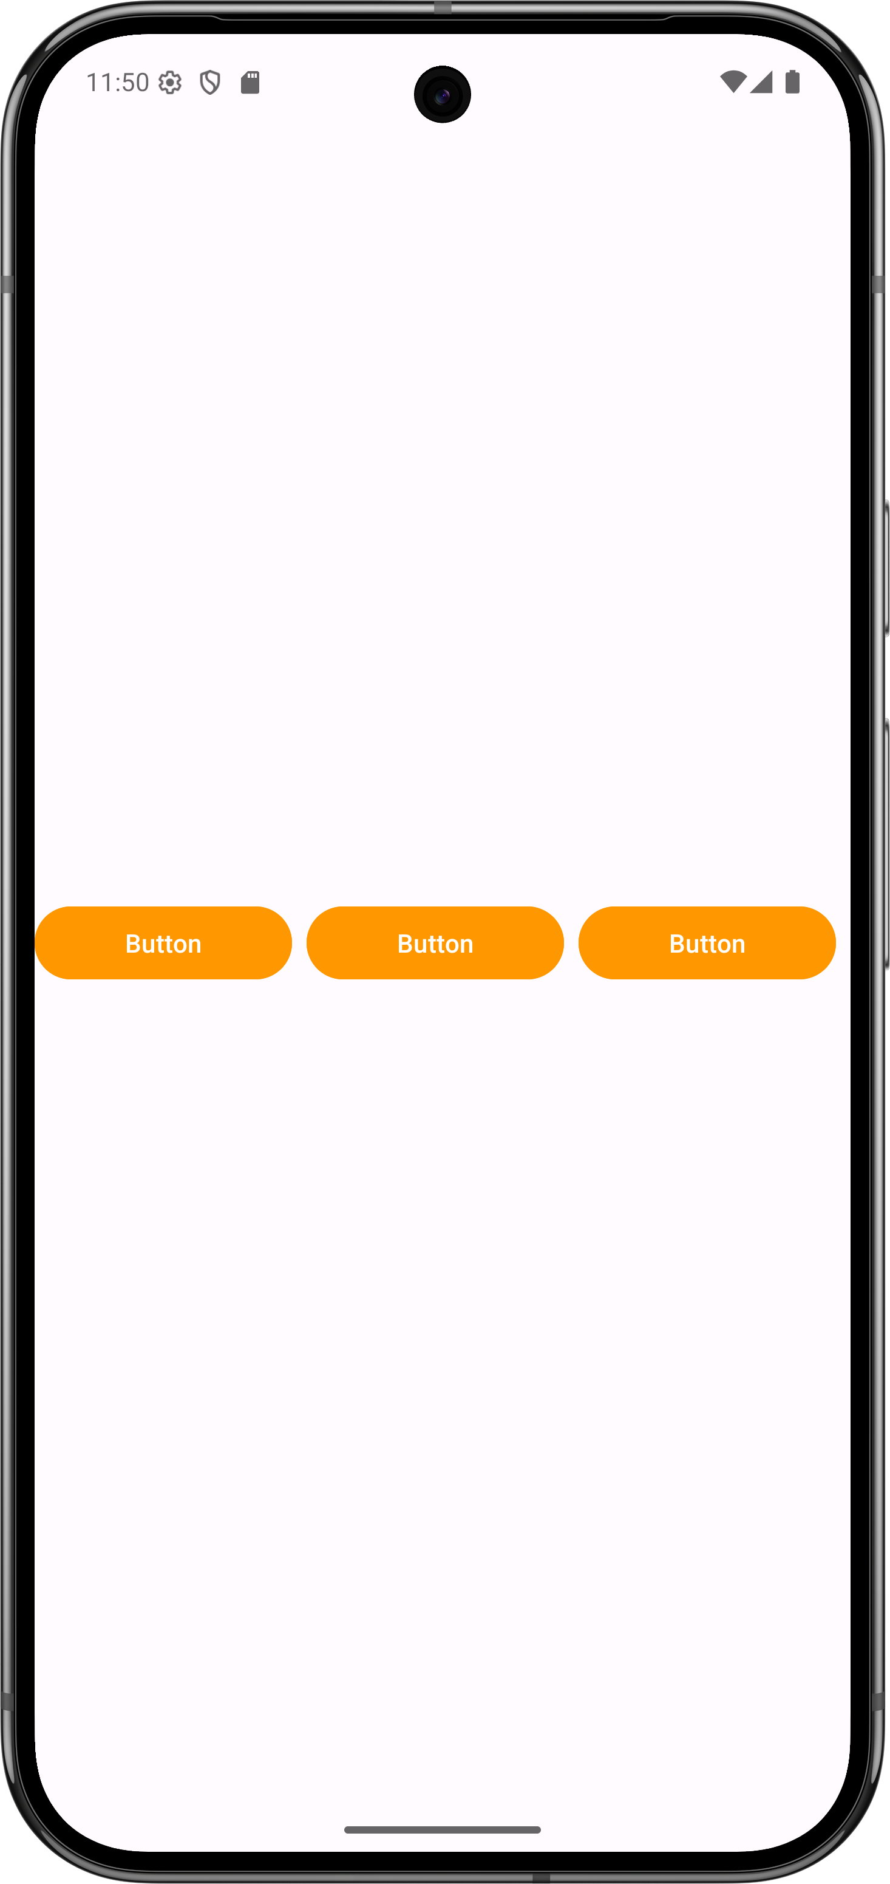
Linear Layout (Horizontal)
activity_main.xml
LinearLayout
Button
Button
Button

Slide 22
Linear Layout (Vertical)
LinearLayout
Button
Button
View

Slide 23
Constraint Layout
Default layout for new Android Studio project
ViewGroup that offers flexibility for layout design
Provides constraints to determine positions and alignment of UI elements
Constraint is a connection to another view, parent layout, or invisible guideline

Slide 24
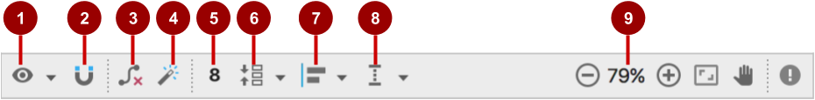
ConstraintLayout toolbar in layout editor
Show: Show Constraints and Show Margins
Autoconnect: Enable or disable
Clear All Constraints: Clear all constraints in layout
Infer Constraints: Create constraints by inference
Default Margins: Set default margins
Pack: Pack or expand selected elements
Align: Align selected elements
Guidelines: Add vertical or horizontal guidelines
Zoom controls: Zoom in or out

Slide 25
Autoconnect
Enable Autoconnect in toolbar if disabled
Drag element to any part of a layout
Autoconnect generates constraints against parent layout

Slide 26
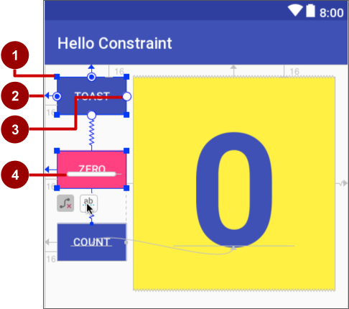
ConstraintLayout handles
Resizing handle
Constraint line and handle
Constraint handle
Baseline handle

Slide 27

Align elements by baseline
Click the baseline constraint button
Drag from baseline to other element's baseline

Slide 28
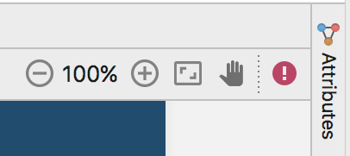
Attributes pane
Click the Attributes tab
Attributes pane includes:
Margin controls for positioning
Attributes such as layout_width

Slide 29
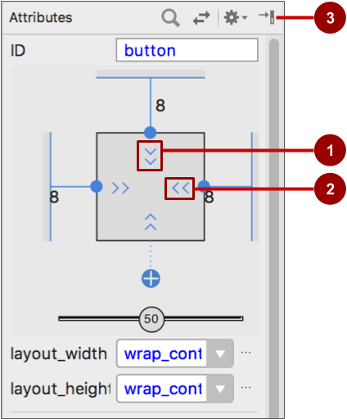
Attributes pane view inspector
Vertical view size control specifies layout_height
Horizontal view size control specifies layout_width
Attributes pane close button

Slide 30

Layout_width and layout_height
layout_width and layout_height change with size controls
match_constraint: Expands element to fill its parent
wrap_content: Shrinks element to enclose content
Fixed number of dp (density-independent pixels)

Slide 31
References
https://adapty.io/blog/android-layouts-and-views/#:~:text=In%20Android%2C%20a%20View%20(%20public,display%20components%20in%20an%20app.
https://developer.android.com/develop/ui/views/layout/declaring-layout

Slide 32
END

